Slide 1


CYBERSEC AS A MISSION

Slide 2


Milestone
Steady growth since the beginning
Climbing the Top 100 Technology Companies in Bulgaria ranking
Positively influencing the work of over 100k employees
    Mnemonica was founded as a major EMC storage integrator, the company also has expertise in servers, virtualization and system administration
2009
    Mnemonica begins to train, certify its team in the field of information security. A company’s portfolio includes a number of security products and services.
2014
2016
    Mnemonica starts offering consultations and services related to regulatory compliance of business in Bulgaria
10+ data storage innovations/year
1 576+ successful projects from 2009 to 2022
36 Mn€ turnover since establishment
5+ data security innovations/year
    The company started offering information security services in cloud-based environments.
2022

Slide 3
Security Services
SOC 24/7 | Information Security and Audit | Regulatory Compatibility | Investigation | Training and Prevention
Security Information and Event Management | Penetration Testing | Compliance Checks (GDPR, PCI-DSS, ISO 27001, AML, Whistleblowing) | Cyber Triage | General IT Security Training
Breach Prevention | Vulnerability Assessment | IT Procedure Preparation | Crisis Management and Enterprise Communications | Deep Cyber Security Training for Professionals
Incident Detection | Web Application Security Testing | GAP Analysis | Post Incident Recovery Services | Anti – Social Engineering Training
Data Exfiltration Prevention | Network Security Testing | Impact Assessment Analysis |  | Cyber Consulting Services
Proactive Data Monitoring | Infrastructure Security Testing | GDPR Solutions Deployment
SOAR Implementation | Internal IT Audit | NIS 1, NIS 2, NIST
 | Risk Mitigation | DORA

Slide 4

Network Security and Regulations
Key aspects of network security and regulatory practices
Security Measures and Network Monitoring
Data Protection and Regulatory Compliance
Regular Audits and Assessments and Employee Awareness and Training

Slide 5

Security Measures and Network monitoring
IPS / IDS / FIREWALL / 2FA / RBAC
SIEM

Slide 6
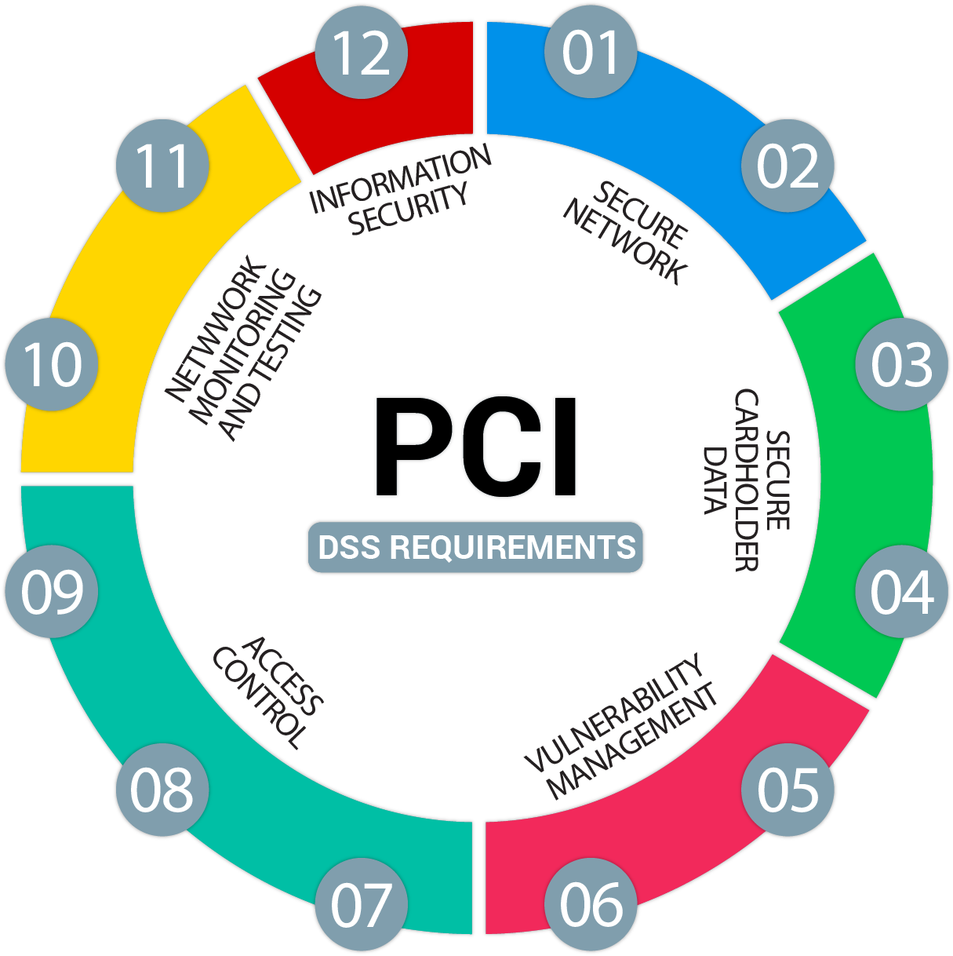
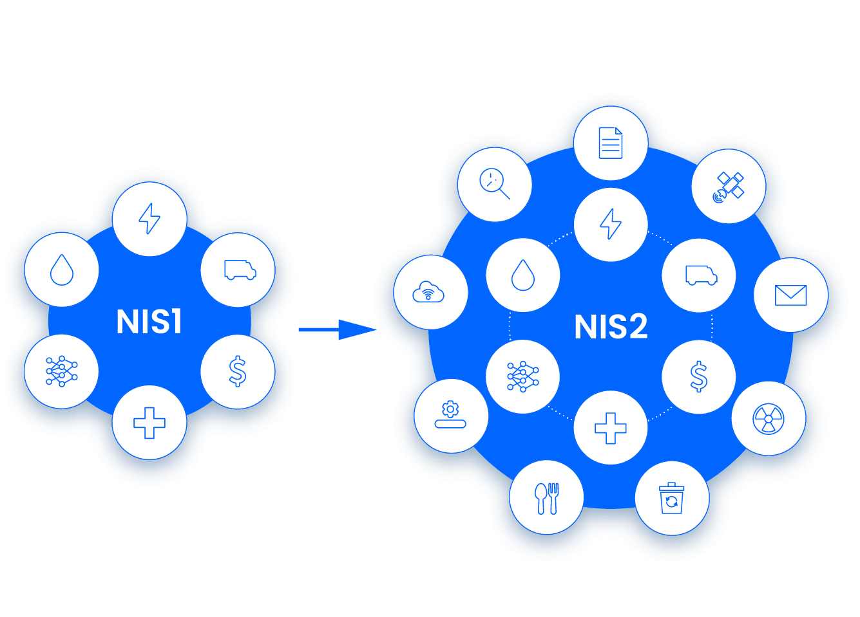
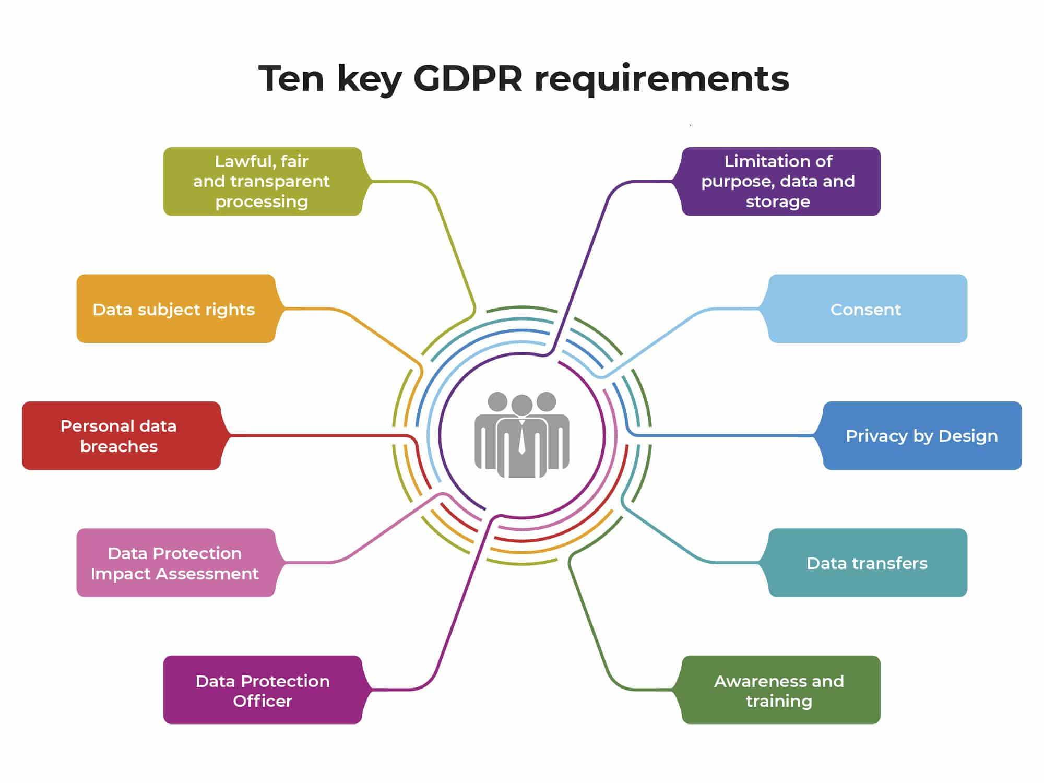

Data Protection and Regulatory Compliance

Slide 7


Regular Audits and Assessments and Employee Awareness and Training

Slide 8







Cloud Security
CASB
Handles ~ of 30 incidents per day
Endpoint Security
Server Security
Conducts ~ 60 investigations per day
Investigates ~ 25 alerts per day
Performs ~ 20 additional (threat hunting) investigations per day
Security Operations
Network Security
Data Protection

Slide 9
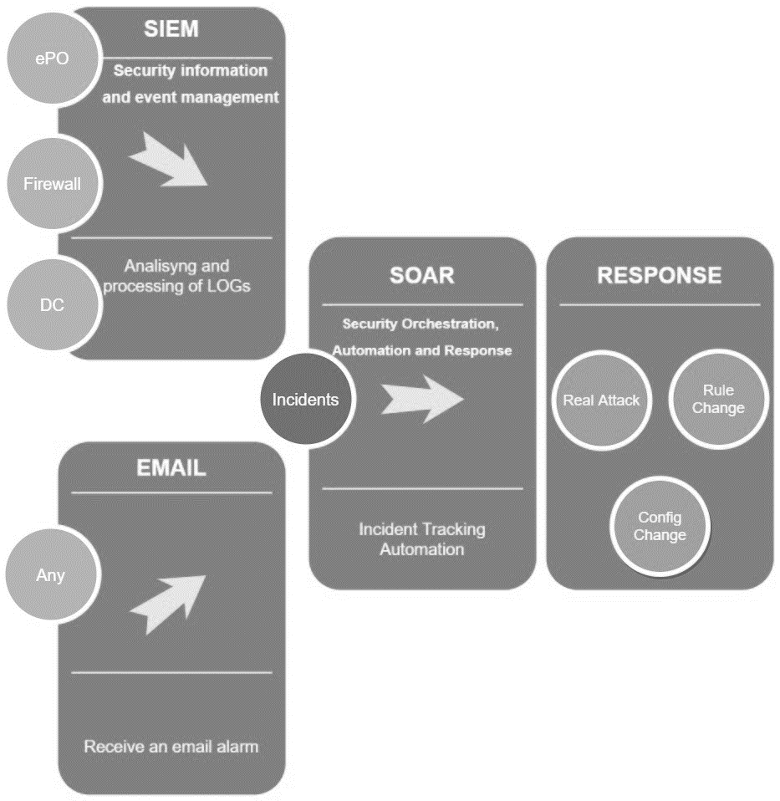
SOC Structure
SOC Running
SOC
Incident:
Change
Solution:
Operate
Investigate
Config change
Rule change
Real attack
IT Sec Monitoring
Receive Events
Correlate
Rule building

Slide 10
Thank you for your attention!

